Slide 1
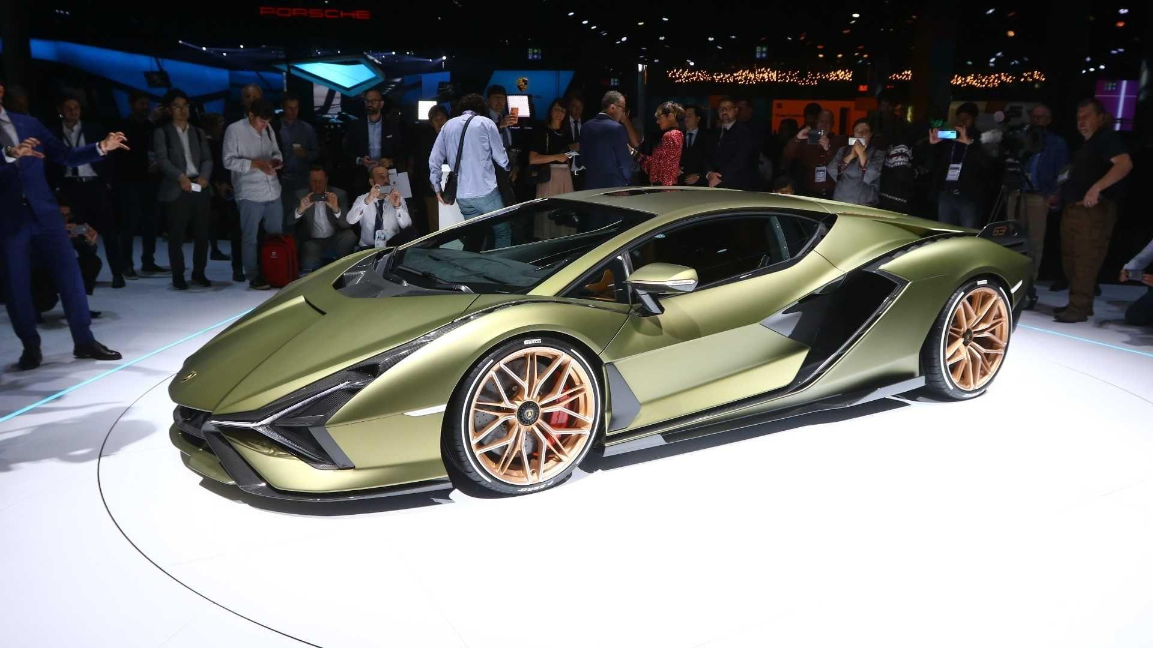

Speed, Velocity and Acceleration Calculations
We will calculate speed, velocity and acceleration
Notes:
Insert cover image and use transparency settings to fade image.

Slide 2
Do not delete this slide.
This slide is designed so that you can copy the prompt box you need and insert it into your slides.
This slide is hidden and will not be included when presenting your lesson.
TRACK WITH ME
VOCABULARY
1 -
HINT
Students, remember….
CHECK FOR UNDERSTANDING
READ WITH ME
TEACHER CUE
MAKE THE CONNECTION
Students, you already know….
EXTENSION
GESTURE WITH ME

Slide 3
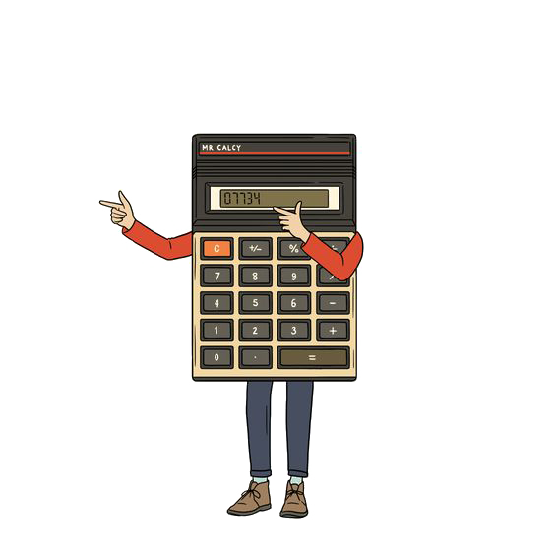
DO NOW
Convert the following speeds to km/h
a) 30 m/s
Convert the following speeds into m/s
a) 64 km/h
3. Describe a motion that has zero displacement.
4. A person runs 50m north, then 20m south and then 30m west. What is the total distance covered? What is the person’s displacement?
Take out your calculators

Slide 5
DISTANCE vs DISPLACEMENT

Slide 6
SPEED VS VELOCITY
Speed | Velocity
Both are a measure of the rate of motion. (rate means an amount per unit of time)
Both use units such as km/h and m/s (kilometres per hour & metres per second)
Is a scalar quantity based upon distance. | Is a vector quantity based upon displacement.

Slide 7
We will calculate speed, velocity and acceleration
TRACK WITH ME
READ WITH ME
We will calculate speed and velocity using formula
We will calculate acceleration using formula
DECLARE THE OBJECTIVE
Read the learning objective to your partner.
Notes:
Learning Objectives contain concepts (nouns, big ideas), skills (verbs, measurable behaviours) and sometimes context (restricting or targeting conditions).
●Example: Students will be able to describe the concept of density and apply it to floating and sinking.
●
Success criteria are specific measurable outcomes that if met mean that the student has met the learning objective.
Examples:
•Students will be able to compare densities of substances using mass and volume.
•Students will be able to identify whether a solid or liquid will float or sink in a liquid based on their densities.

Slide 8
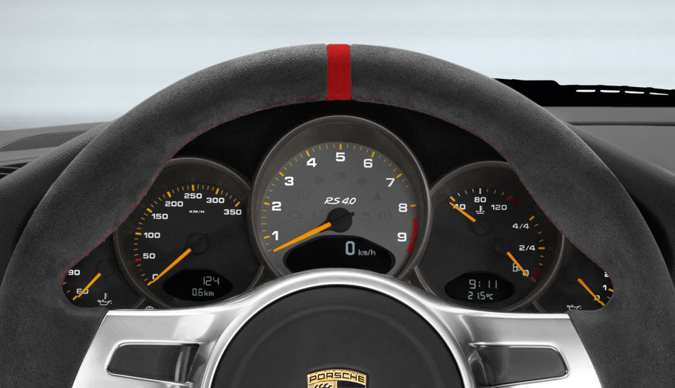
We will convert between different metric units and rearrange formula
Instantaneous vs. Average Speed
Over the course of a trip, the speed typically varies.
When I’m driving my car, how can I check my instantaneous speed?
When I’m driving my car, how do I check my average speed for a trip?

Slide 9
We will convert between different metric units and rearrange formula
Speed = Distance
Time
Example 1: If a ball rolls 30m in 15 seconds how fast does it travel?
Example 3: Thomas flew his plane at a speed of 70m/s for 10 minutes. How far did he travel?
Example 2: Mary was driving at 25m/s. How long did it take her to drive 500m?
D
S
T

Slide 10
Problem 1: A train travels 6.1 m/s East. The train’s destination is 134 km east. How long until it arrives?
You Try!
HINT
Remember that velocity is a vector and needs a direction in your final answer!
Problem 2: The Mars rover, Curiosity, has a maximum speed of only 0.14 km/h.
If Curiosity travels North for 60.0s, what is its displacement ?
D
Problem 3: What is the velocity of a jet that travels 785m West in 2.39s ?
S
T

Slide 11

V₂ = final velocity
V₁ = initial velocity
t = elapsed time
We will convert between different metric units and rearrange formula
Acceleration = V₂ – V₁
t
VOCABULARY
= delta In mathematics, delta is used to represent ‘change in’
What units will acceleration have?
V
To solve an acceleration problem, you will need to know 3 values to solve for the fourth. Look out for key phrases like “from rest” or “to a stop”
These tell the velocity without using values!
A
T

Slide 12
V₂ = final velocity
V₁ = initial velocity
t = elapsed time
We will convert between different metric units and rearrange formula
Acceleration = V₂ – V₁
t
Example 1: A bus accelerates from 5m/s East to 25m/s East in 10 seconds. What was its acceleration?
V
1. What values do we have and what are we trying to find?
2. Are the units for distance and time the same?
A
T
3. What formula are we going to use?
4. Let’s solve!

Slide 13
V₂ = final velocity
V₁ = initial velocity
t = elapsed time
We will convert between different metric units and rearrange formula
Acceleration = V₂ – V₁
t
Example 2: A car had an acceleration of 10m/s² North in 20 seconds. What was its change in velocity?
V
1. What values do we have and what are we trying to find?
2. Are the units for distance and time the same?
A
T
3. What formula are we going to use?
4. Let’s solve!

Slide 14
V₂ = final velocity
V₁ = initial velocity
t = elapsed time
We will convert between different metric units and rearrange formula
Acceleration = V₂ – V₁
t
Example 2: How long did it take Stuart to finish the same race if he had an acceleration of 0.3m/s² and a speed of 6m/s?
V
1. What values do we have and what are we trying to find?
2. Are the units for distance and time the same?
A
T
3. What formula are we going to use?
4. Let’s solve!

Slide 15
Problem 1: A horse begins a race from rest with an acceleration of 2.2m/s² North What is the horse’s velocity after 5.8 seconds?
You Try!
HINT
Remember that acceleration and velocity are vectors and need a direction in your final answer!
Problem 2: A limousine driver notices a stop sign while travelling 55 km/h. What is the acceleration (in m/s²) of the limousine if it comes to a complete stop in 4.3s? Interpret the sign of acceleration – what does it mean?
V
Hint: Let South be positive and North negative in your calculation
Problem 3: During an AFL game, a defender changes direction from running 4.5m/s North to 4.5m/s South over 8 seconds. What is the acceleration of the defender during that time?
A
T

Slide 16
Problem 1: A horse begins a race from rest with an acceleration of 2.2m/s² North What is the horse’s velocity after 5.8 seconds?
Answers
HINT
Remember that acceleration and velocity are vectors and need a direction in your final answer!
V
A
T

Slide 17
You Try!
Problem 2: A limousine driver notices a stop sign while travelling 55 km/h. What is the acceleration (in m/s²) of the limousine if it comes to a complete stop in 4.3s? Interpret the sign of acceleration – what does it mean?
HINT
Remember that acceleration and velocity are vectors and need a direction in your final answer!
V
A
T

Slide 18
Problem 3: During an AFL game, a defender changes direction from running 4.5m/s North to 4.5m/s South over 8 seconds. What is the acceleration of the defender during that time?
You Try!
HINT
Remember that acceleration and velocity are vectors and need a direction in your final answer!
Hint: Let South be positive and North negative in your calculation
V
A
T

Slide 19
Enter Learning Objective
Complete the Homework questions on these calculations
Add picture

Slide 20
Enter Learning Objective
CHECK FOR UNDERSTANDING
VOCABULARY

Slide 21
Enter Learning Objective
Task
Task
CHECK FOR UNDERSTANDING
HINT
Students, remember….
VOCABULARY
Notes:
Please include tasks/questions here rather than just referring to a worksheet. This will save on photocopying and facilitate sharing with other schools.
Try and build tasks/questions which escalate through Bloom’s Taxonomy. This will help with differentiation.

Slide 22
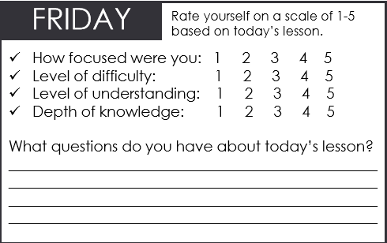

We will calculate speed, velocity and acceleration
TRACK WITH ME
READ WITH ME
We will calculate speed and velocity using formula
We will calculate acceleration using formula
Notes:
Learning Objectives contain concepts (nouns, big ideas), skills (verbs, measurable behaviours) and sometimes context (restricting or targeting conditions).
●Example: Students will be able to describe the concept of density and apply it to floating and sinking.
●
Success criteria are specific measurable outcomes that if met mean that the student has met the learning objective.
Examples:
•Students will be able to compare densities of substances using mass and volume.
•Students will be able to identify whether a solid or liquid will float or sink in a liquid based on their densities.

Slide 23
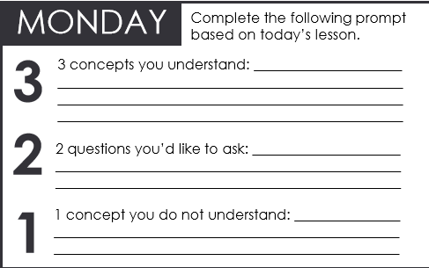
We will convert between different metric units and rearrange formula
TRACK WITH ME
READ WITH ME
We will describe the difference between speed and velocity
We will convert between km/h and m/s
We will rearrange formulas to change the subject
CHECK FOR UNDERSTANDING
Check Success Criteria.
Notes:
Learning Objectives contain concepts (nouns, big ideas), skills (verbs, measurable behaviours) and sometimes context (restricting or targeting conditions).
●Example: Students will be able to describe the concept of density and apply it to floating and sinking.
●
Success criteria are specific measurable outcomes that if met mean that the student has met the learning objective.
Examples:
•Students will be able to compare densities of substances using mass and volume.
•Students will be able to identify whether a solid or liquid will float or sink in a liquid based on their densities.

